Slide 1


Slide 2
AGENDA
What We Will Cover
› The Opportunity
› Program Goals
› The Farmer Package
› Technology Ecosystem
› Theory of Change
› Implementation Roadmap
› Governance & Leadership
› Financial Model
› Fundraising & Sponsorship
› Risk Management
› Monitoring & Impact
› Sustainability & Vision
› Africa Deployment
› Call to Action
Catholic Project Fund · AAADI Stakeholder Presentation
2

Slide 3
Executive Summary
A twenty-four-month, $8,125,000,000 initiative sponsored by the Catholic Project Fund to turn 5 million smallholder farmers across eight African countries into higher-yield agricultural entrepreneurs — with hardware, connectivity, AI, drones, payments, and visualization intelligence bundled into a single $1,625 package per farmer.
5M
$8.1B
8
24
$1,625
5
Sponsored Farmers
Total Budget
Countries
Months
Per Farmer
Tech Partners
› Five integrated platforms — Jozie AI, Aero Ghost, SCM Financials, Beezifi, YouLabs — give every farmer a full precision-agriculture infrastructure
› A disciplined 24-month, two-wave roadmap moves from governance through deployment, curriculum, and a Month-24 continental harvest showcase
› Five sponsorship tiers scale from $1,625 (one farmer) to $812,500,000 (500,000 farmers, Global Partner)
Catholic Project Fund · AAADI Stakeholder Presentation
3

Slide 4
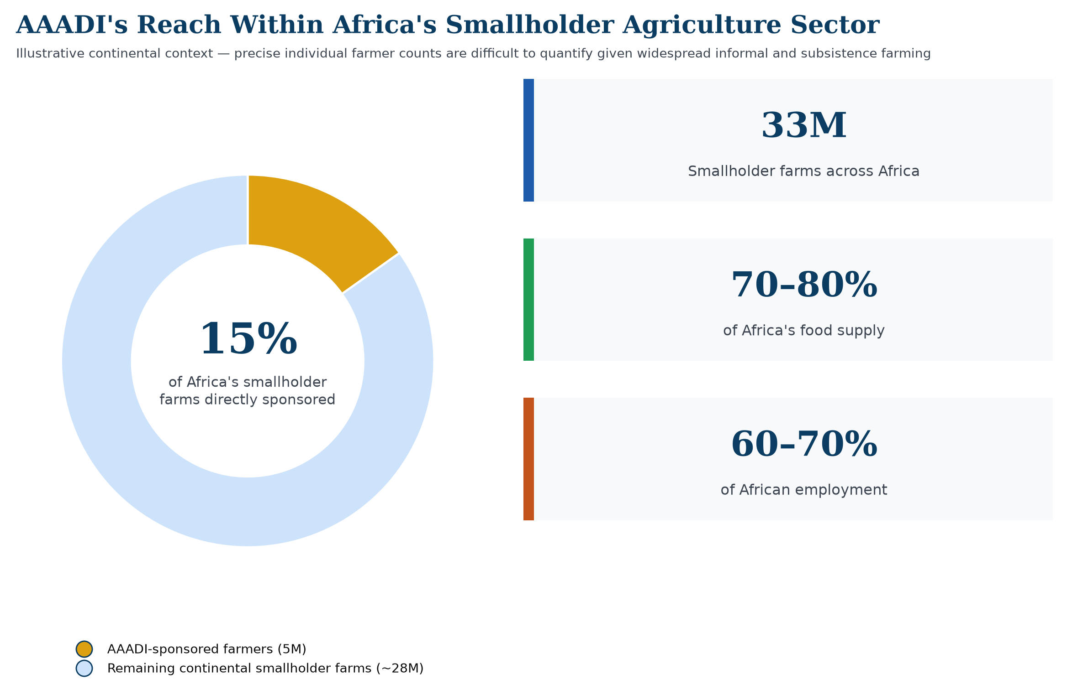
THE OPPORTUNITY
The Scale of the Opportunity
Catholic Project Fund · AAADI Stakeholder Presentation
4

Slide 5
The Opportunity
› Africa's ~33 million smallholder farms produce 70–80% of the continent's food supply and employ 60–70% of its workforce
› Agriculture employs roughly half to two-thirds of the workforce across AAADI's eight countries, dominated by 1-2 hectare smallholder farms
› 1 in 3 smallholder households lacks reliable connectivity
› Extension-officer-to-farmer ratios often exceed 1-to-1,000
› AI and precision drones have collapsed the cost of commercial-grade farming — but only for those with the device, connectivity, and training
› Blanket input-subsidy programs consistently underperform: inputs are routinely over-applied, under-applied, or resold informally without agronomic guidance
Catholic Project Fund · AAADI Stakeholder Presentation
5

Slide 6
Program Goals
$8,125,000,000 — 5,000,000 farmers × $1,625. One transparent unit economic model.
Total funds raised
$8,125,000,000
Farmers sponsored
5,000,000
Countries reached
8
Program duration
24 months
Drone service coverage
≥ 1.5M ha
Farmers with recorded yield increase
≥ 3.9M (78%)
Catholic Project Fund · AAADI Stakeholder Presentation
6

Slide 7
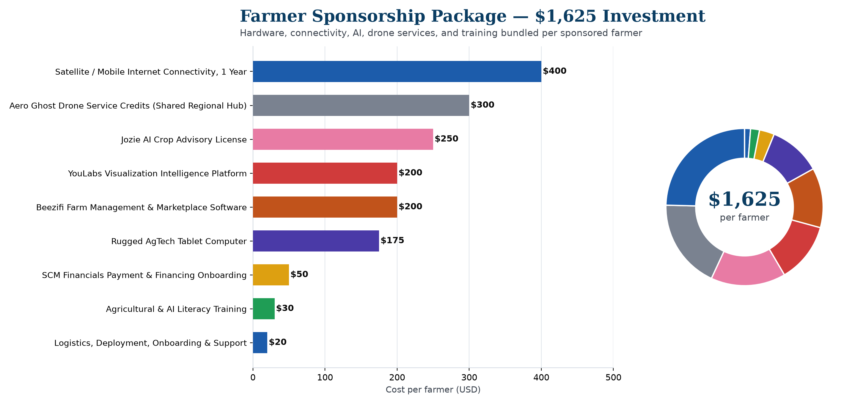
$1,625 PER FARMER
The Farmer Package
Catholic Project Fund · AAADI Stakeholder Presentation
7

Slide 8
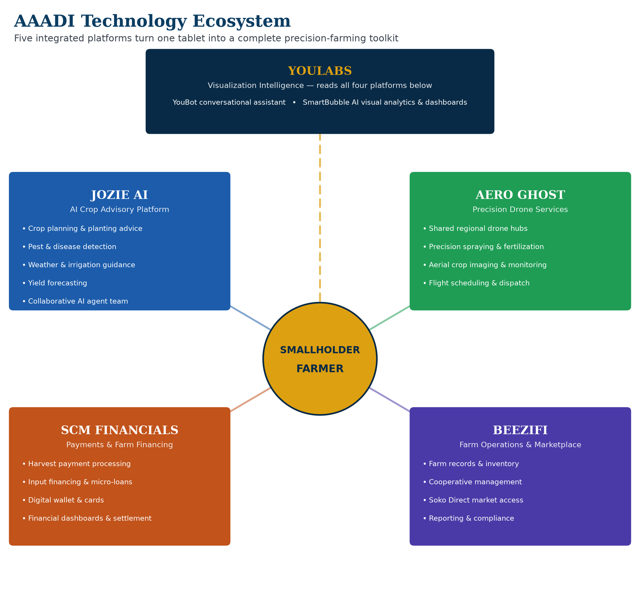
The AAADI Technology Ecosystem
Catholic Project Fund · AAADI Stakeholder Presentation
8

Slide 9
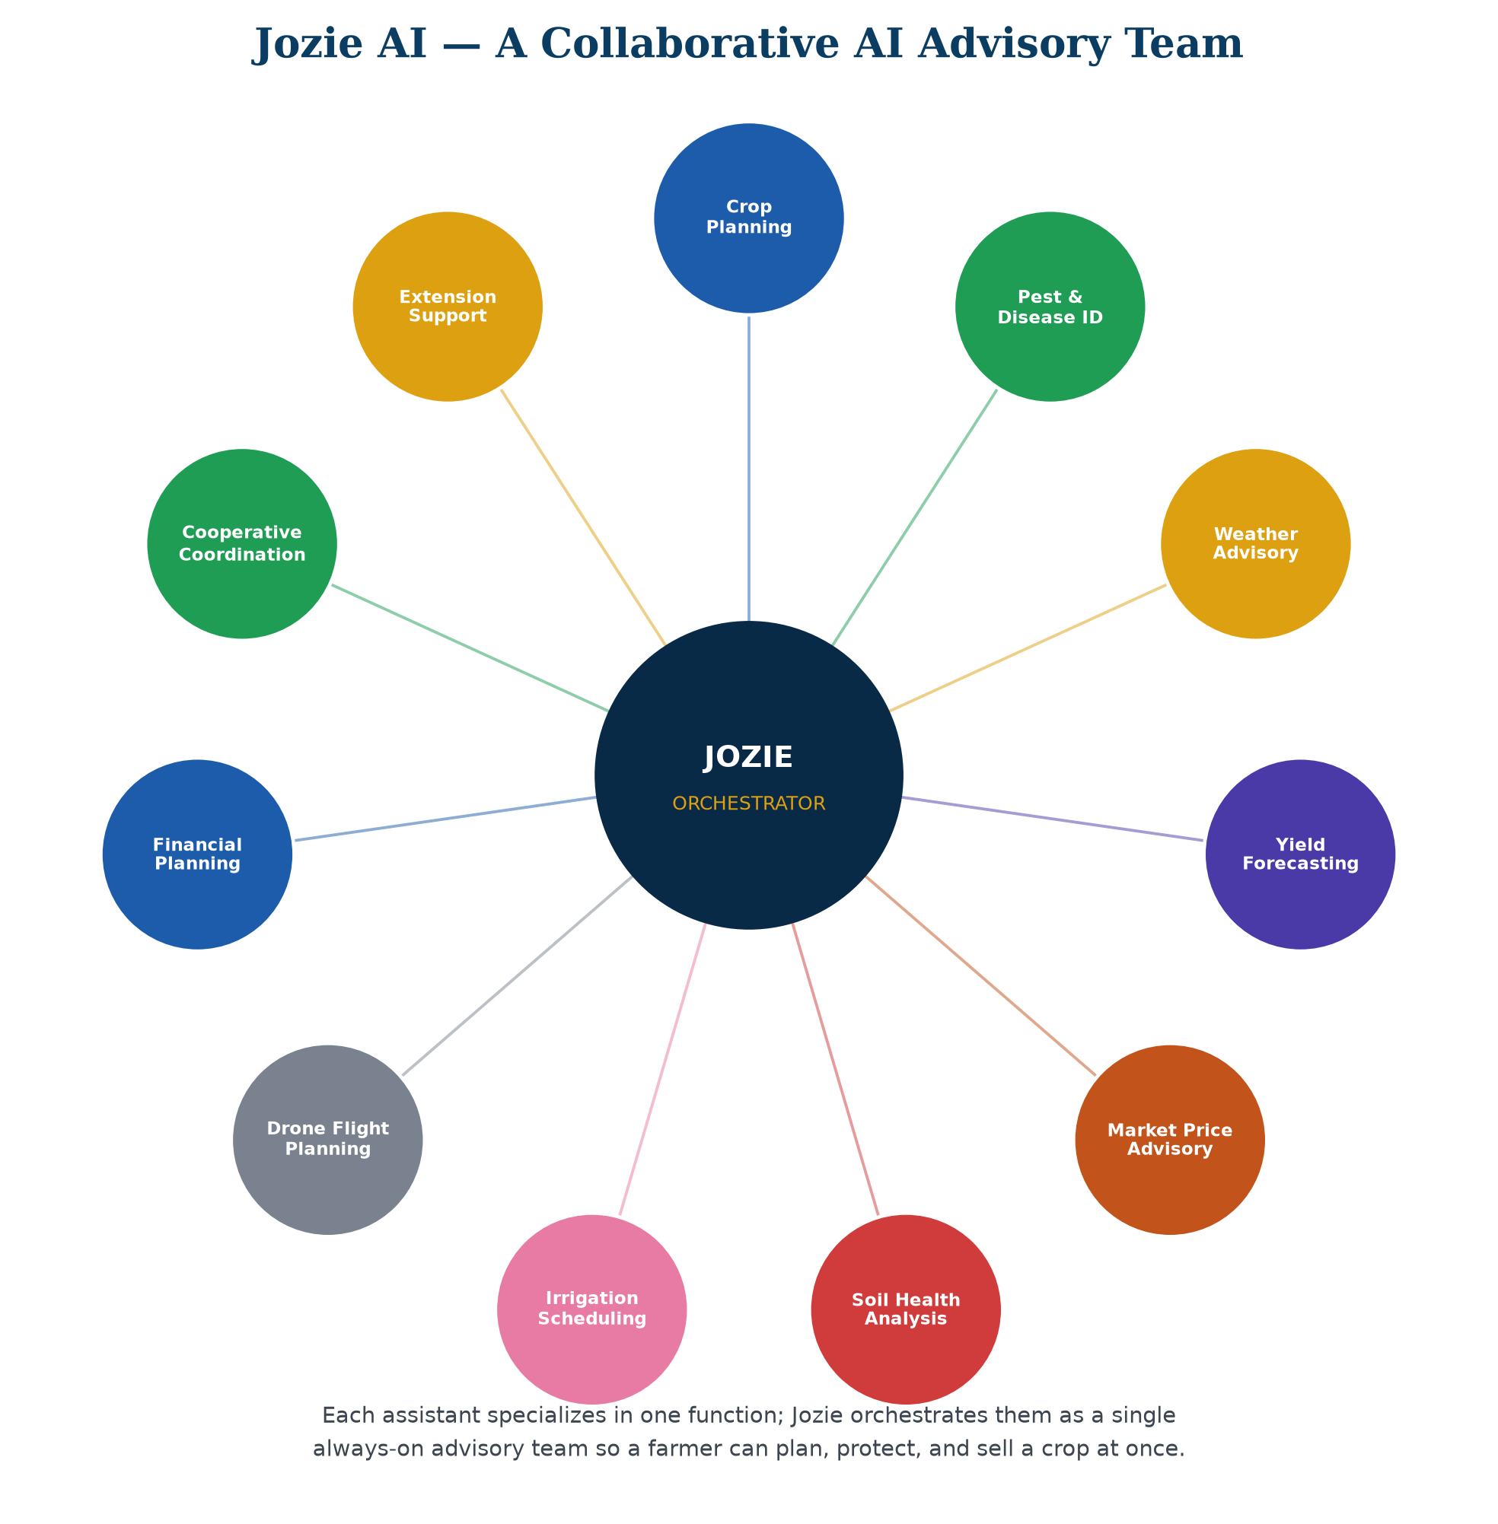
Jozie AI — The AI Crop Advisory Platform
› Crop planning, pest & disease detection, weather & irrigation guidance
› Yield forecasting, market price advisory, financial planning
› Assistants collaborate as one coordinated AI advisory team
Catholic Project Fund · AAADI Stakeholder Presentation
9

Slide 10
Aero Ghost — Precision Drone Services
› Shared regional drone hubs, dispatched on demand
› Precision spraying, fertilization & aerial crop monitoring
› Brings commercial-grade precision agriculture to smallholder economics
Catholic Project Fund · AAADI Stakeholder Presentation
10

Slide 11
SCM Financials — Payments & Farm Financing
› Merchant onboarding built for first-time rural micro-merchants
› Harvest payment processing and input financing
› Digital wallets and financial dashboards
Catholic Project Fund · AAADI Stakeholder Presentation
11

Slide 12
Beezifi — Farm Operations & Marketplace
› Farm records, inventory & cooperative management
› Soko Direct marketplace — direct-to-buyer produce sales
› The operating backbone that keeps a farm organized and connected to market
Catholic Project Fund · AAADI Stakeholder Presentation
12

Slide 13
YouLabs — Visualization Intelligence Platform
› YouBot — plain-language conversational assistant over all four other platforms
› SmartBubble AI — visual dashboards and cross-platform analytics
› Reads data rather than owning it — the same facts, rendered for farmers, Country Directors, and sponsors
Catholic Project Fund · AAADI Stakeholder Presentation
13

Slide 14
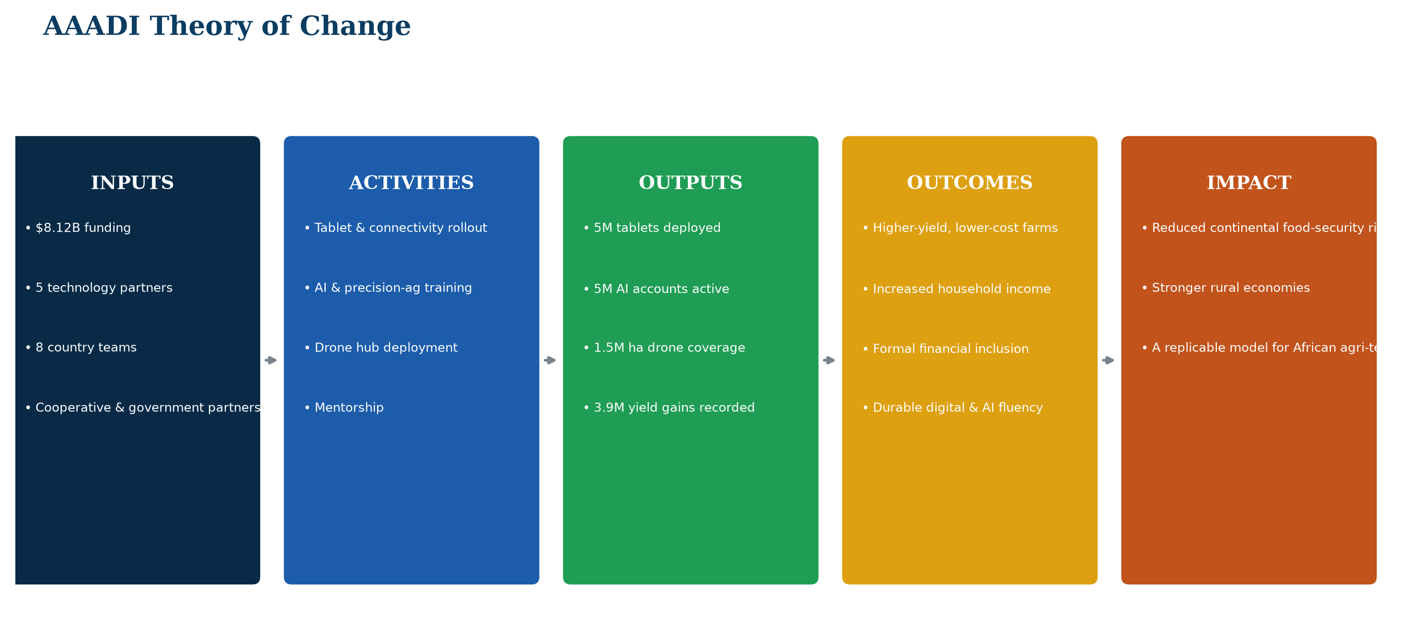
Theory of Change
Catholic Project Fund · AAADI Stakeholder Presentation
14

Slide 15
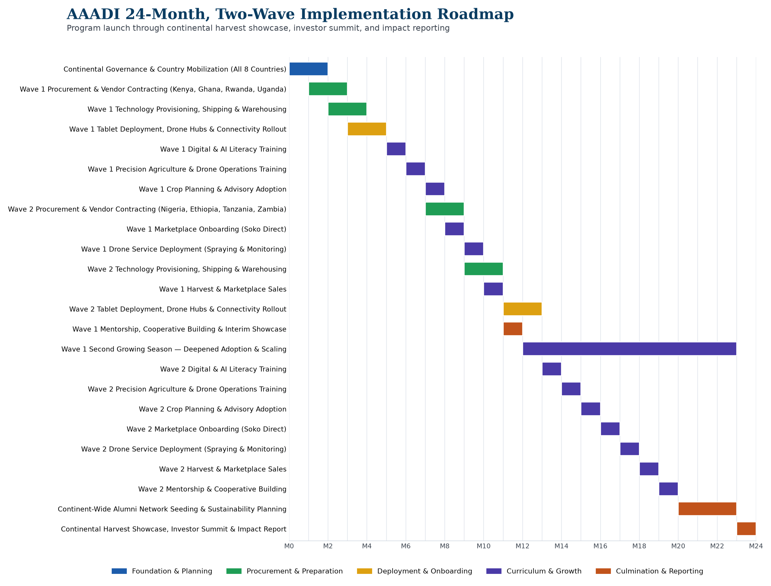
24-Month Implementation Roadmap
Catholic Project Fund · AAADI Stakeholder Presentation
15

Slide 16
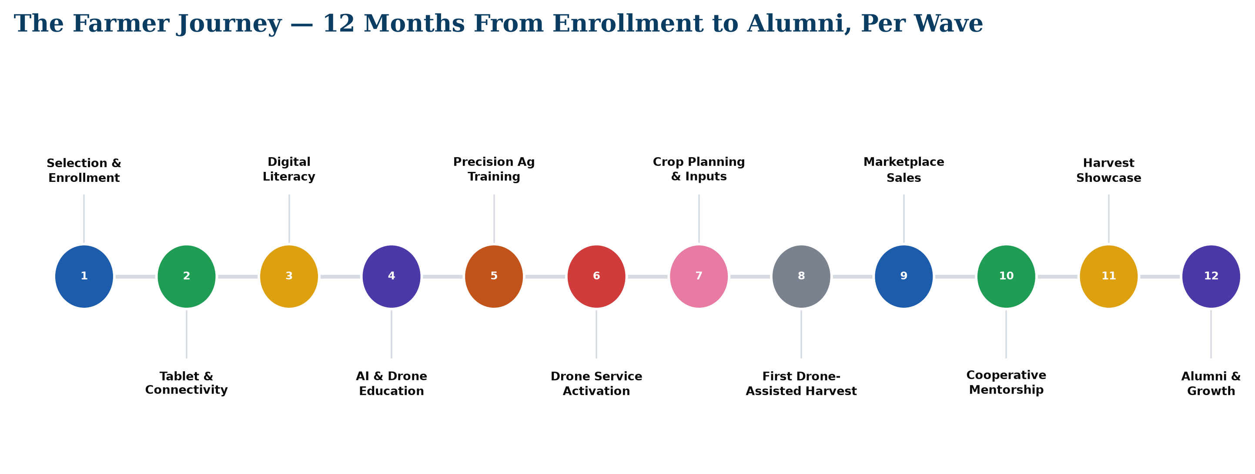
The Farmer Journey
Catholic Project Fund · AAADI Stakeholder Presentation
16

Slide 17
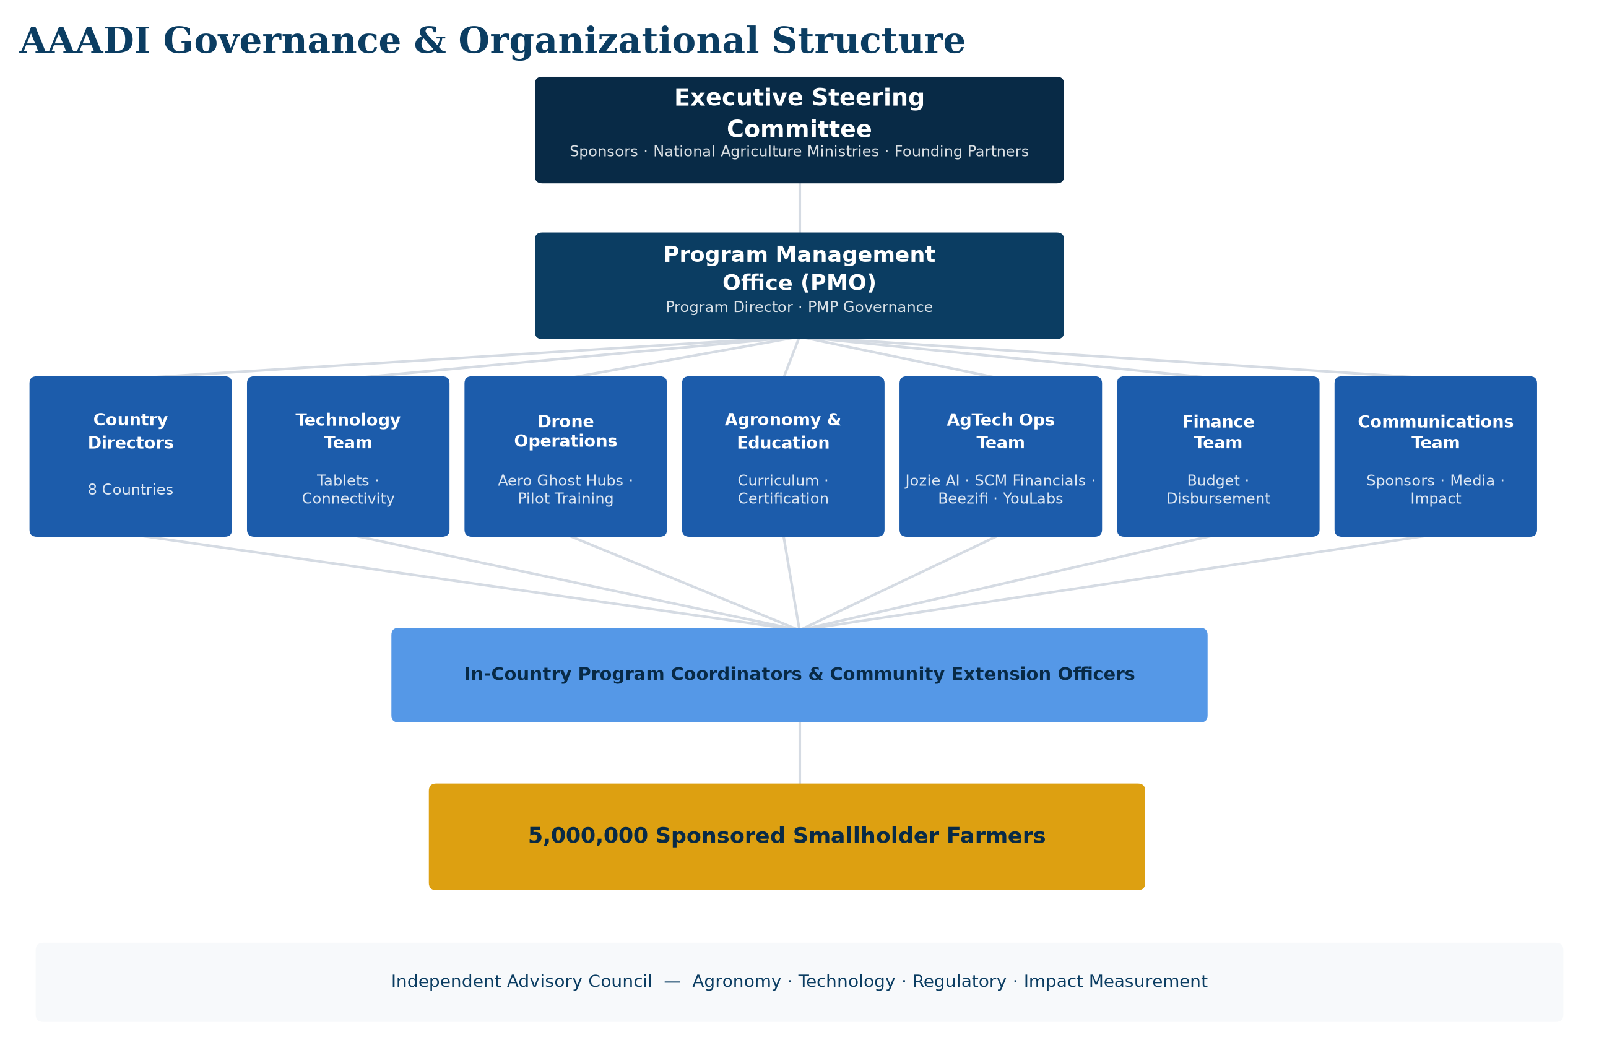
Governance & Organizational Structure
Catholic Project Fund · AAADI Stakeholder Presentation
17

Slide 18
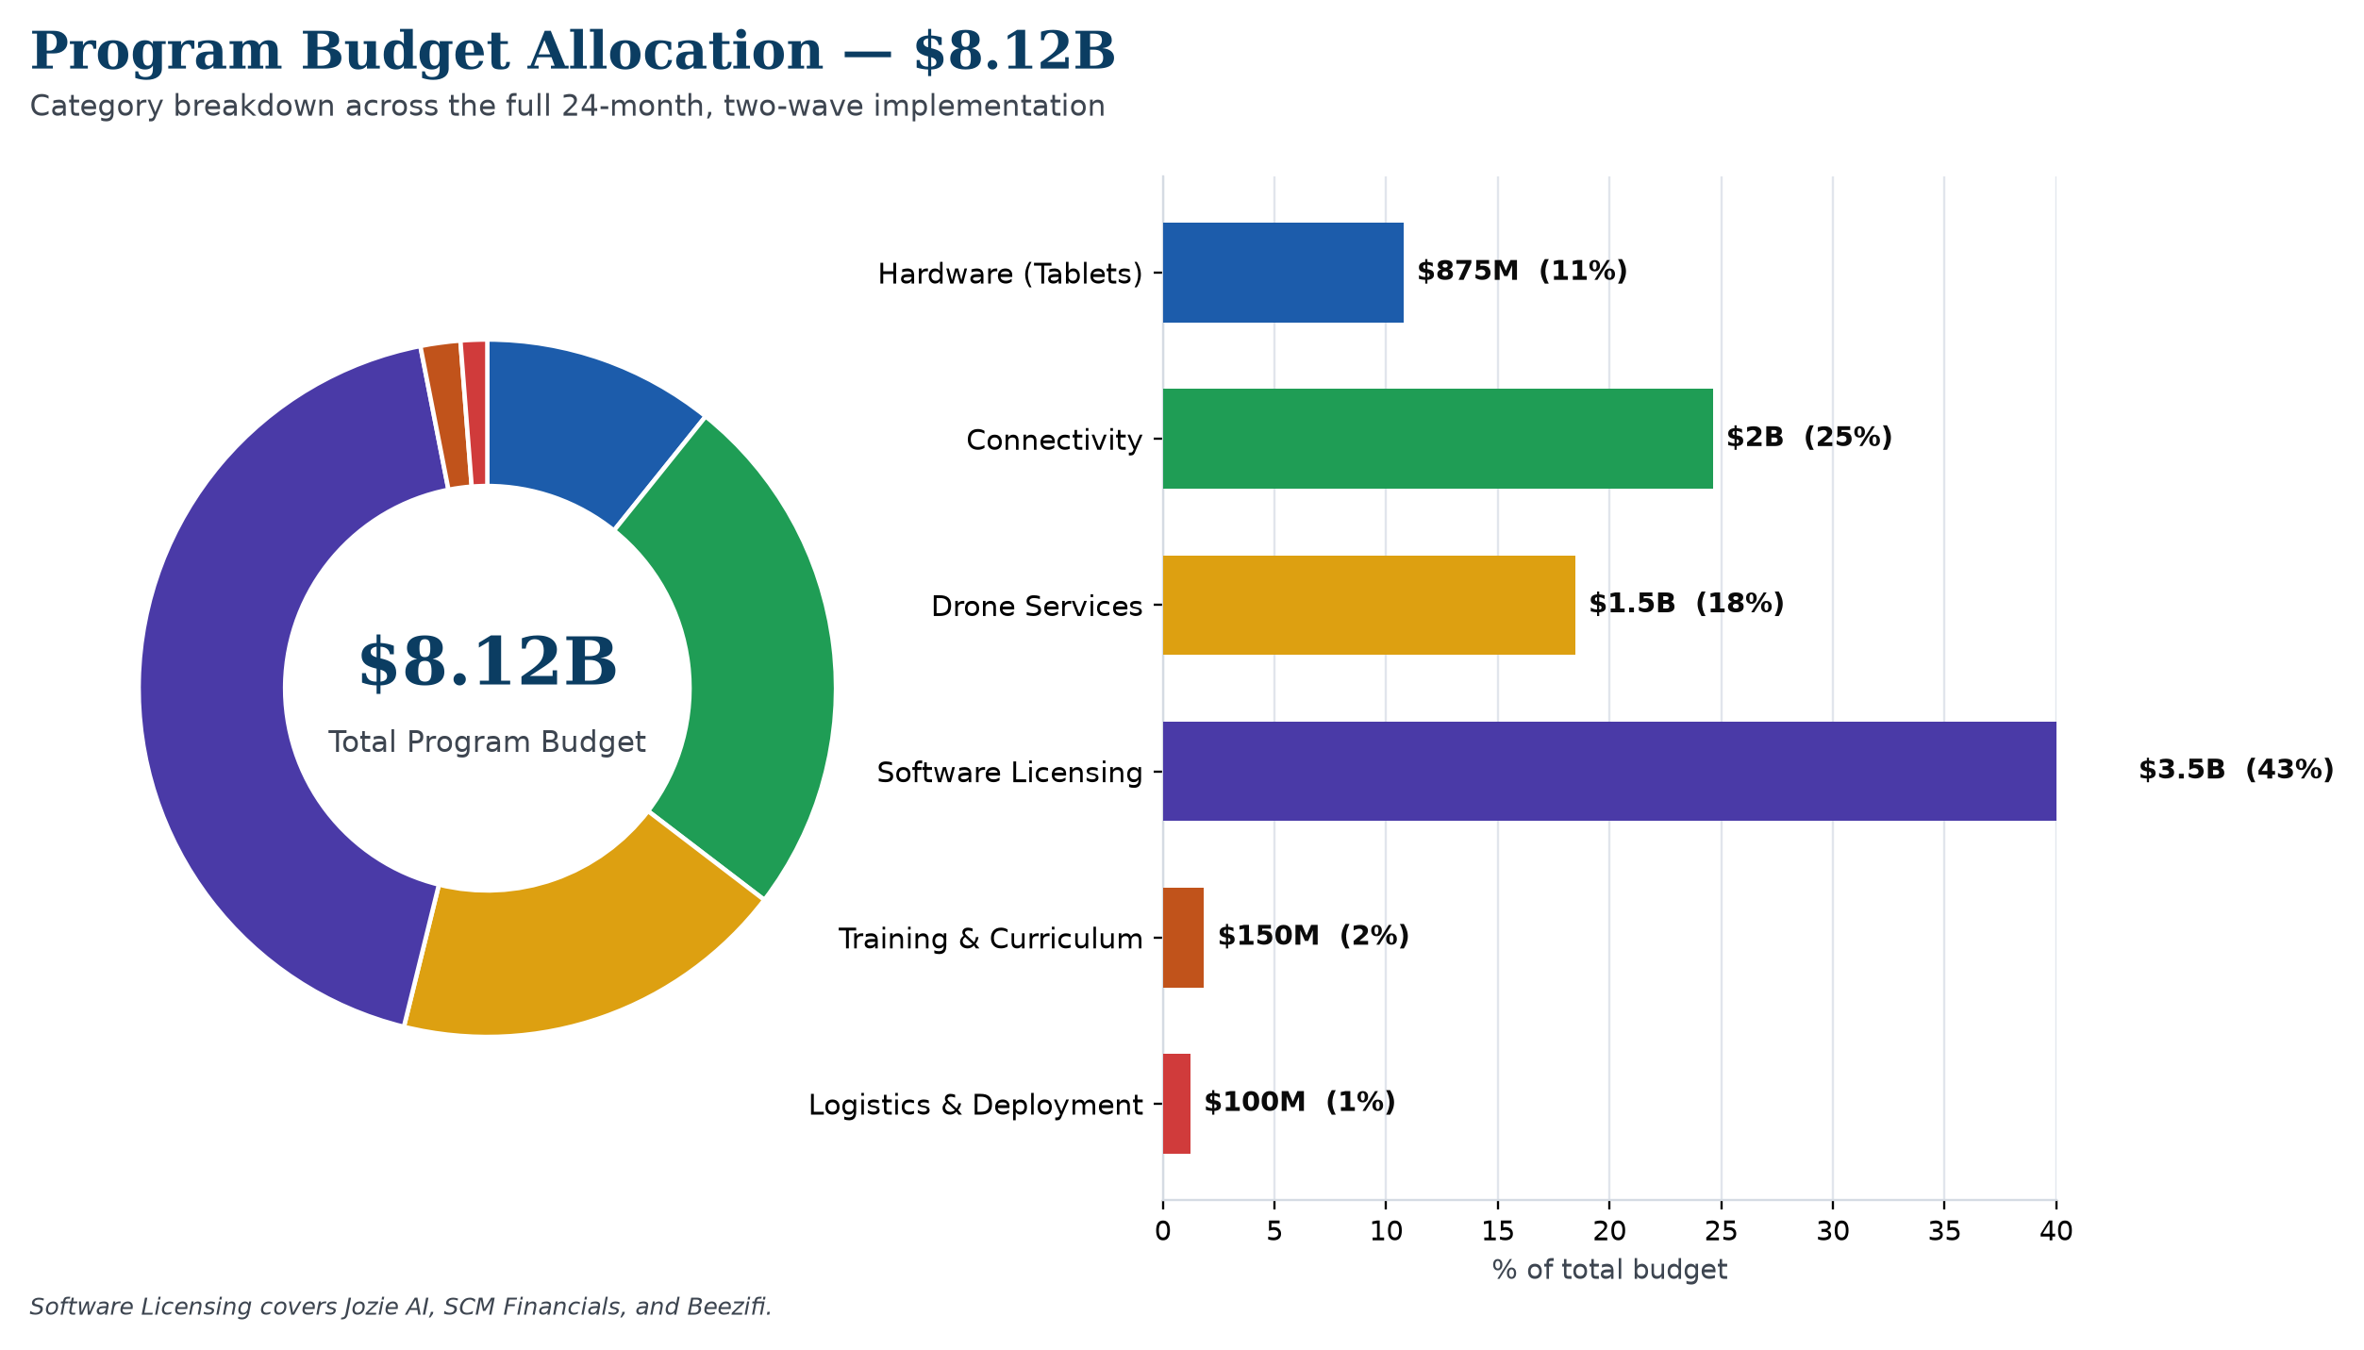
Program Budget — $8,125,000,000
Catholic Project Fund · AAADI Stakeholder Presentation
18

Slide 19
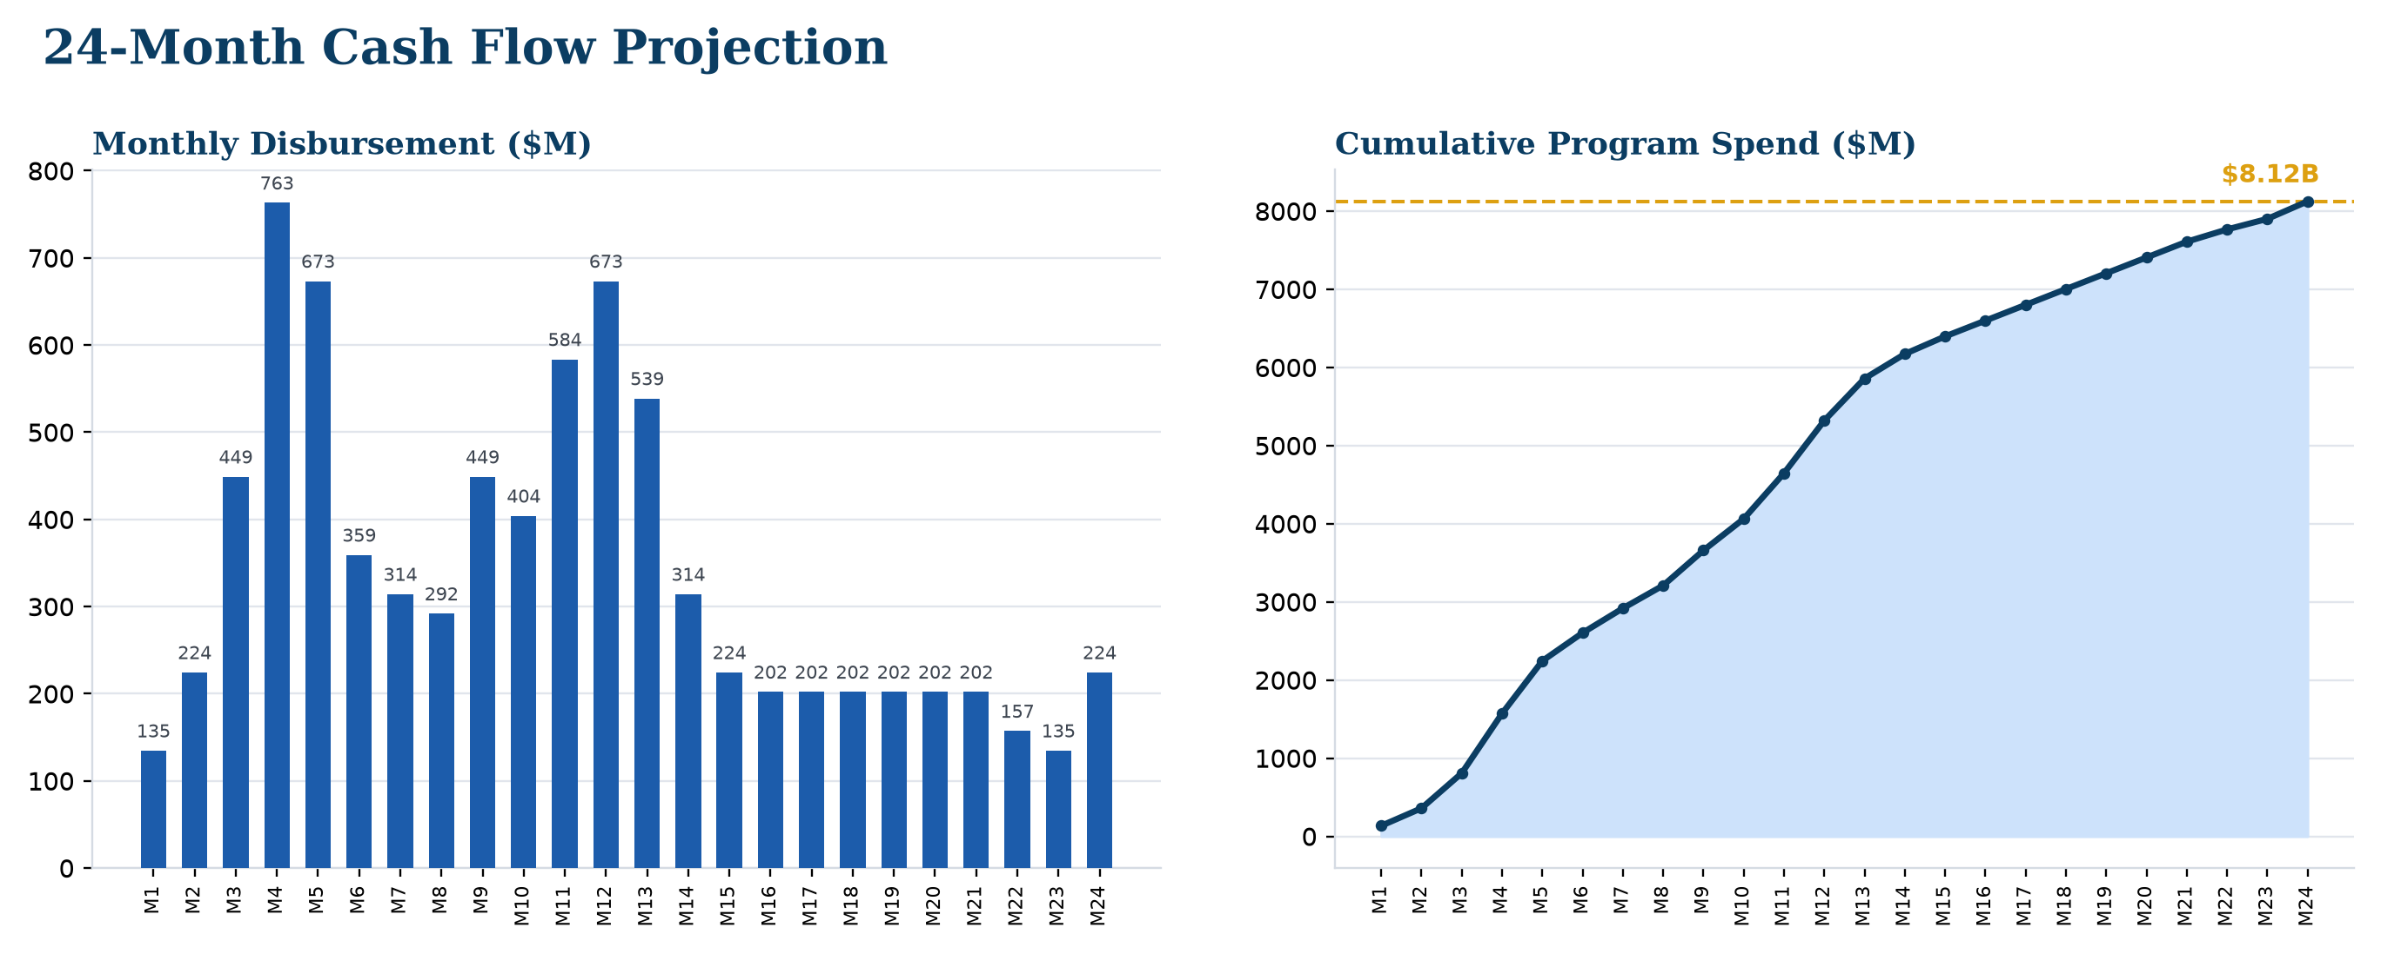
Cash Flow Projection
Catholic Project Fund · AAADI Stakeholder Presentation
19

Slide 20
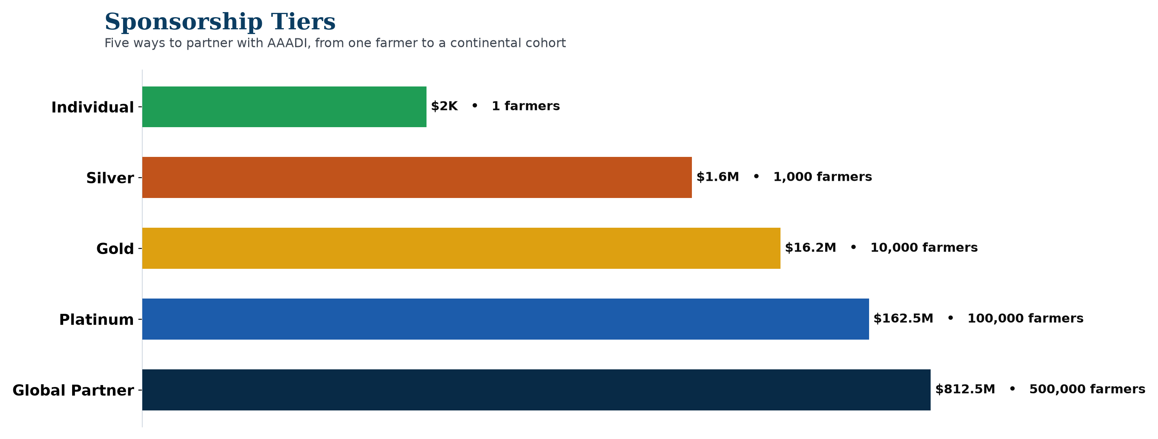
Sponsorship Tiers
Catholic Project Fund · AAADI Stakeholder Presentation
20

Slide 21
Sponsorship Benefits Matrix
Benefit | Global Partner | Platinum | Gold | Silver | Individual
Named recognition | ✓ | ✓ | ✓ | ✓ | —
Logo on annual report cover | ✓ | ✓ | — | — | —
Steering Committee seat | ✓ | — | — | — | —
Audited financials | ✓ | ✓ | ✓ | — | —
Quarterly program report | ✓ | ✓ | ✓ | ✓ | ✓
Harvest showcase invite | ✓ | ✓ | ✓ | ✓ | —
Catholic Project Fund · AAADI Stakeholder Presentation
21

Slide 22
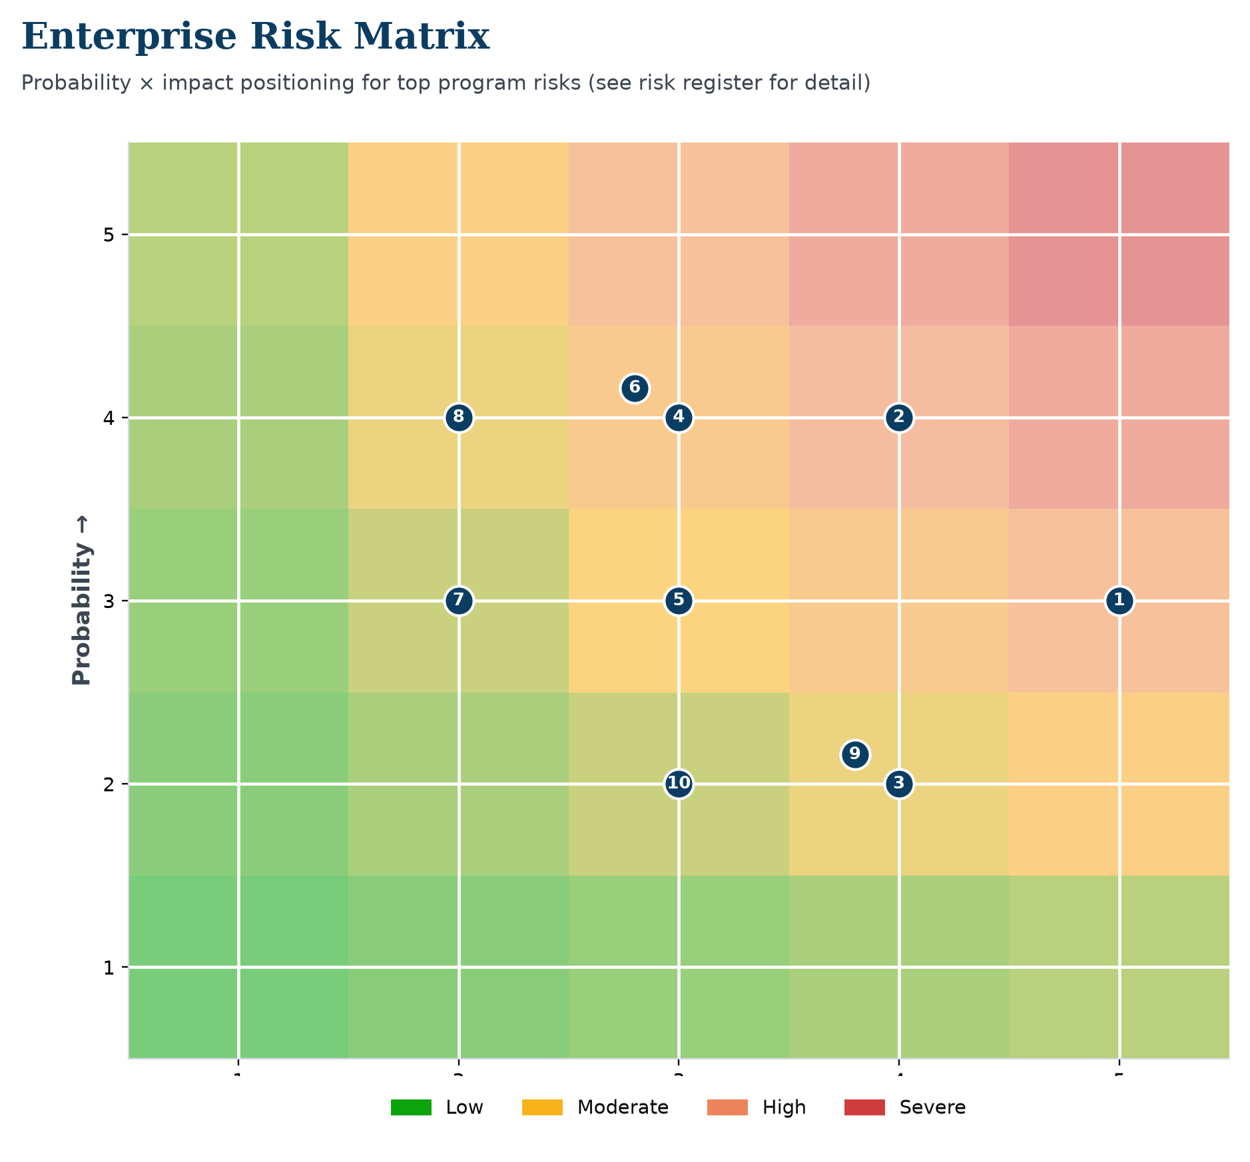
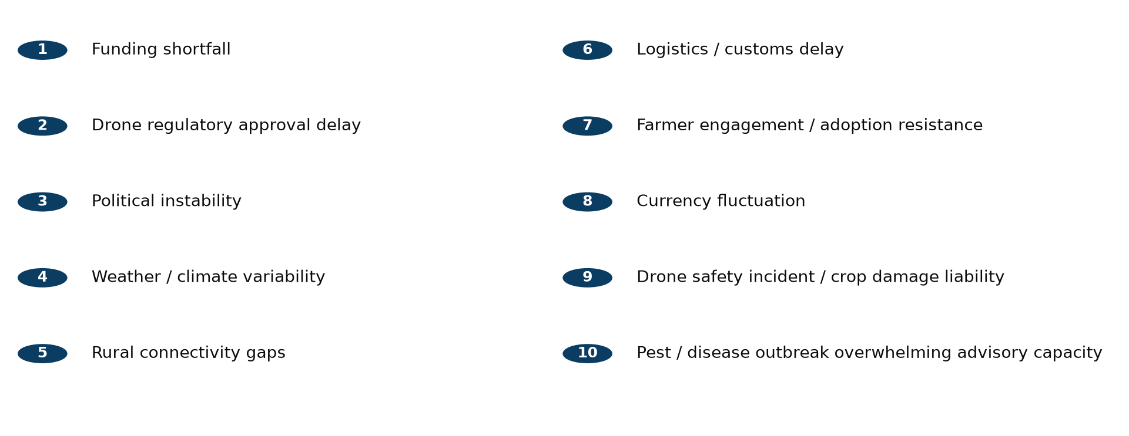
Enterprise Risk Matrix
Catholic Project Fund · AAADI Stakeholder Presentation
22

Slide 23
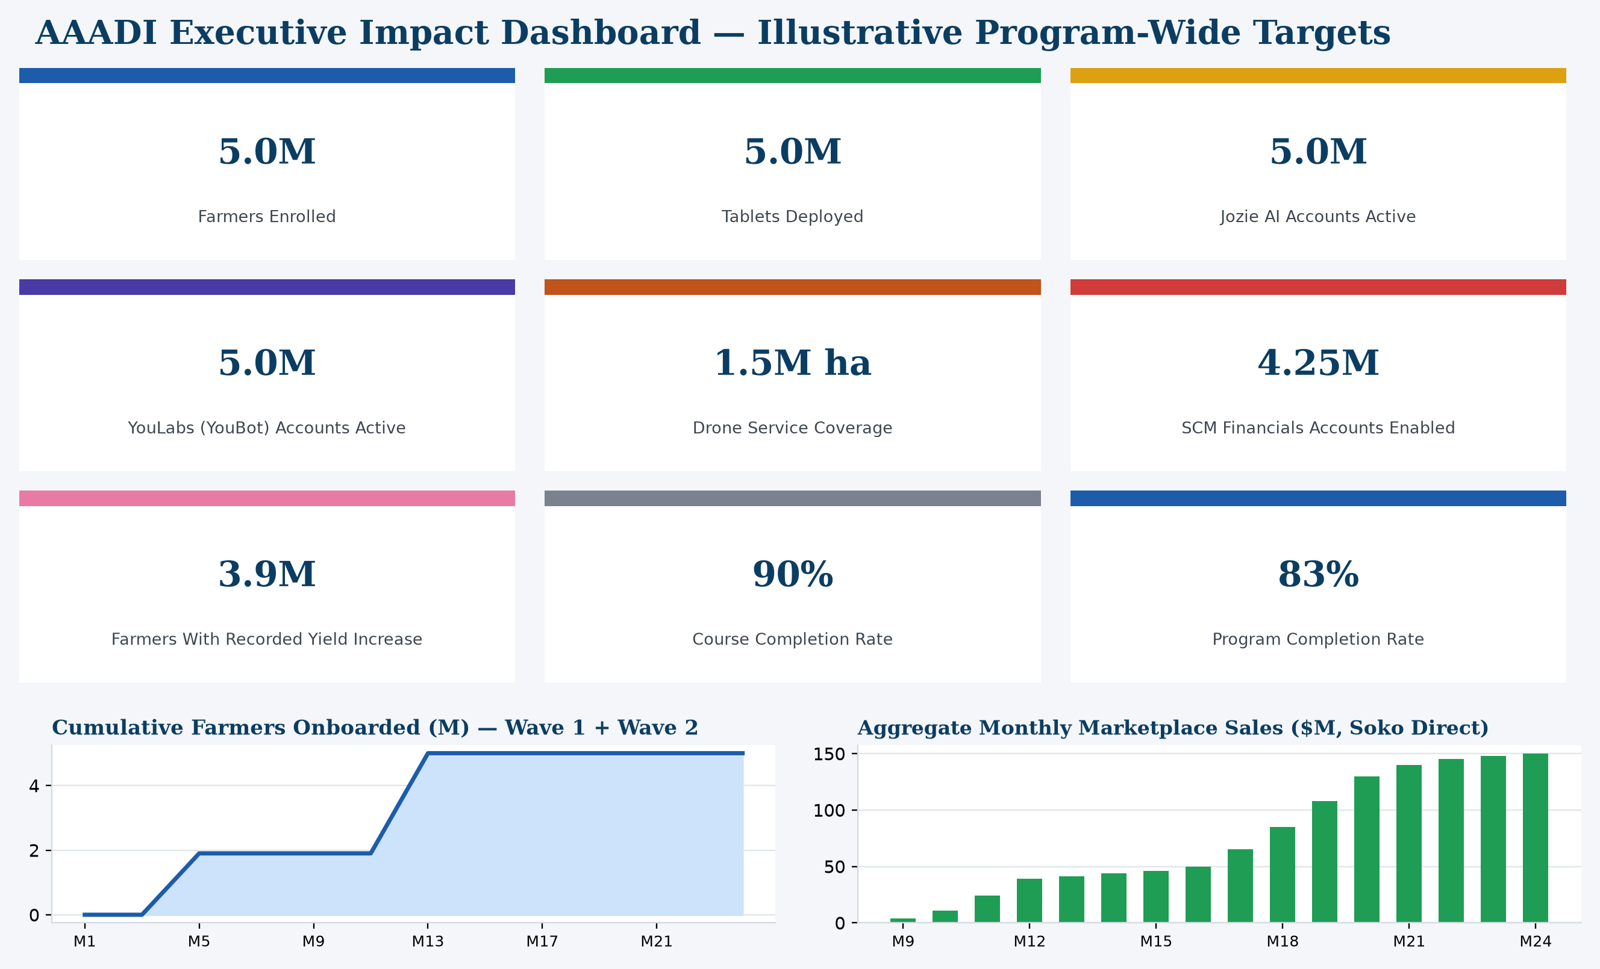
MONITORING & EVALUATION
Executive Impact Dashboard
Catholic Project Fund · AAADI Stakeholder Presentation
23

Slide 24
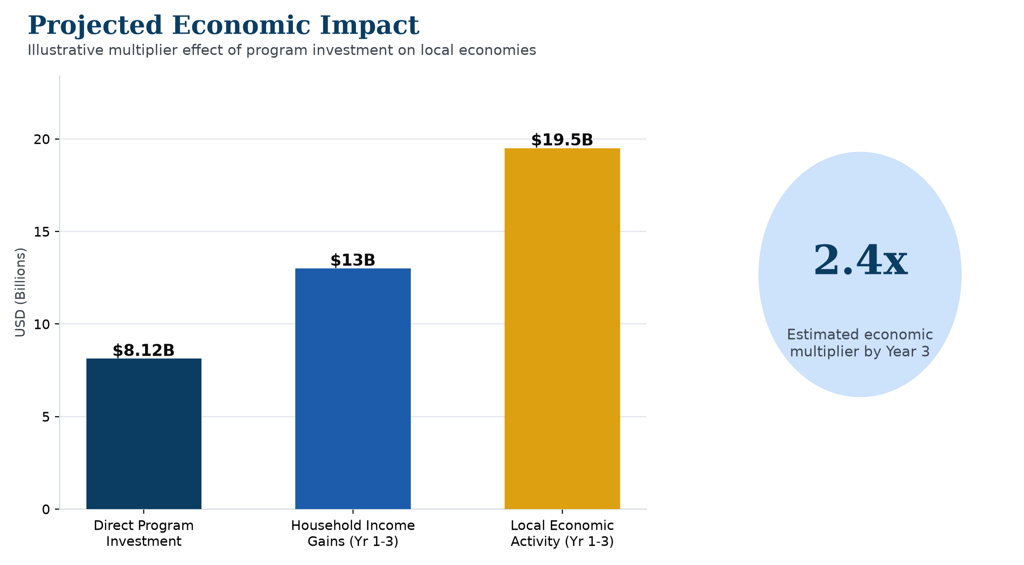
Expected Impact
Catholic Project Fund · AAADI Stakeholder Presentation
24

Slide 25
Sustainability Plan
› Continued platform access — discounted alumni continuation pricing for Jozie AI, Aero Ghost, SCM Financials, Beezifi & YouLabs
› Local partnerships — agrodealers, savings & credit cooperatives, and national agriculture offices
› Reinvestment & alumni network — top farmers mentor and sponsor the next cohort
› Mentorship & growth — each wave's mentors commit to 6+ months of continued informal support
Catholic Project Fund · AAADI Stakeholder Presentation
25

Slide 26
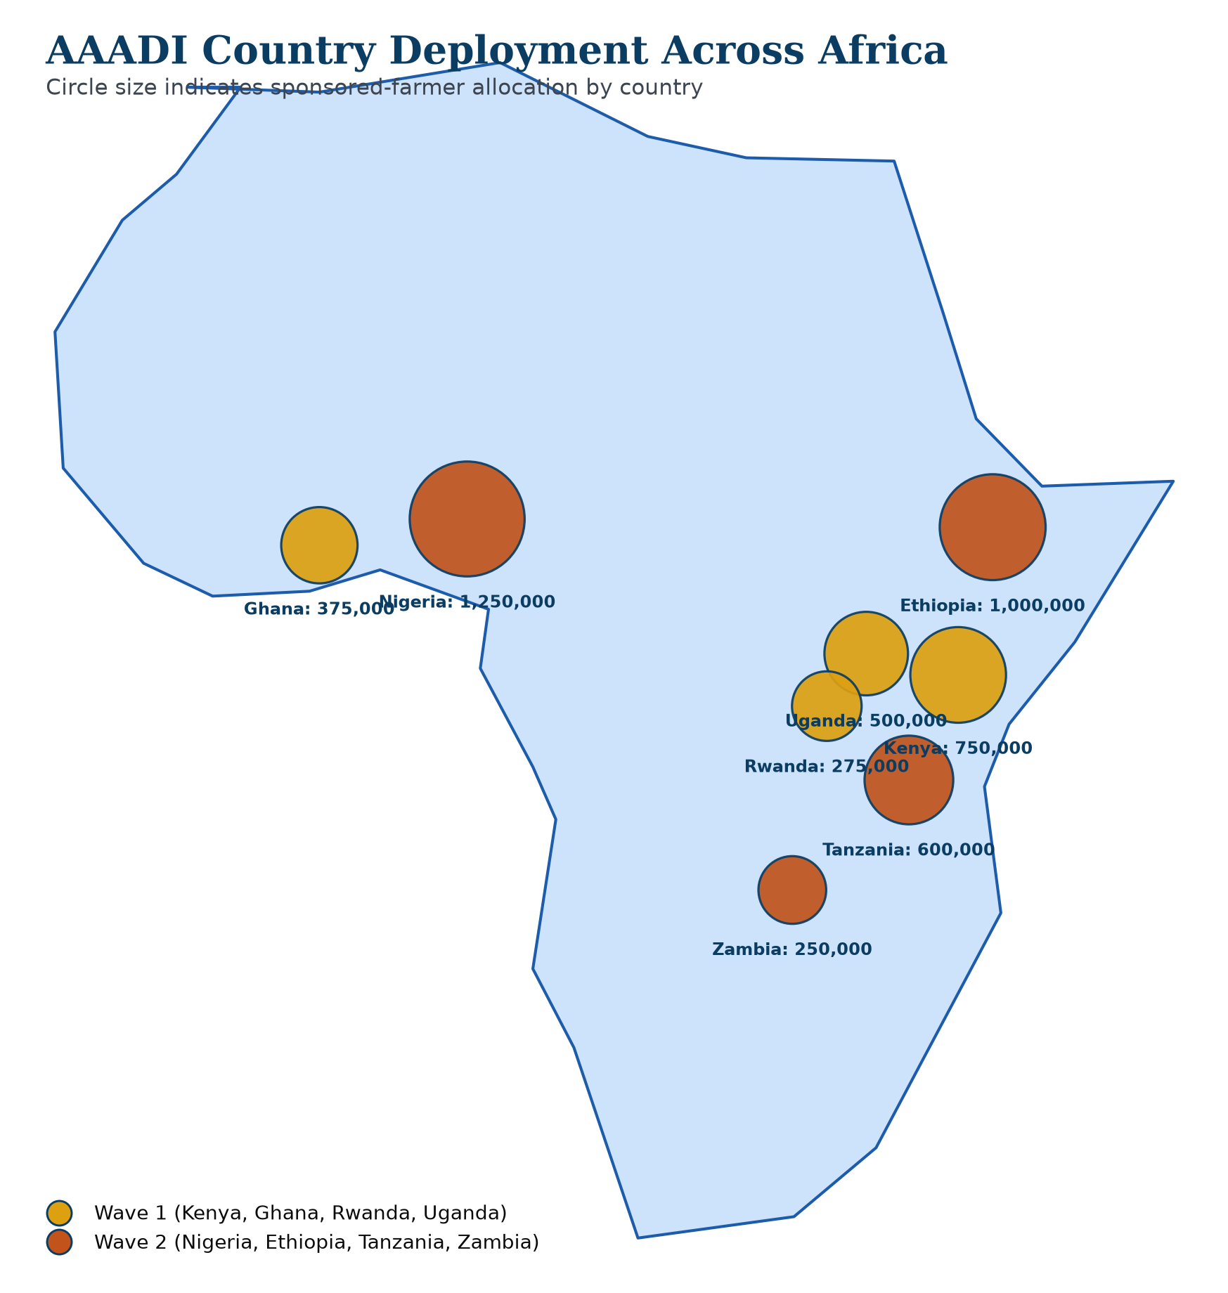
Africa Deployment Plan
Nigeria
1,250,000
Ethiopia
1,000,000
Kenya
750,000
Tanzania
600,000
Uganda
500,000
Ghana
375,000
Rwanda
275,000
Zambia
250,000
Catholic Project Fund · AAADI Stakeholder Presentation
26

Slide 27
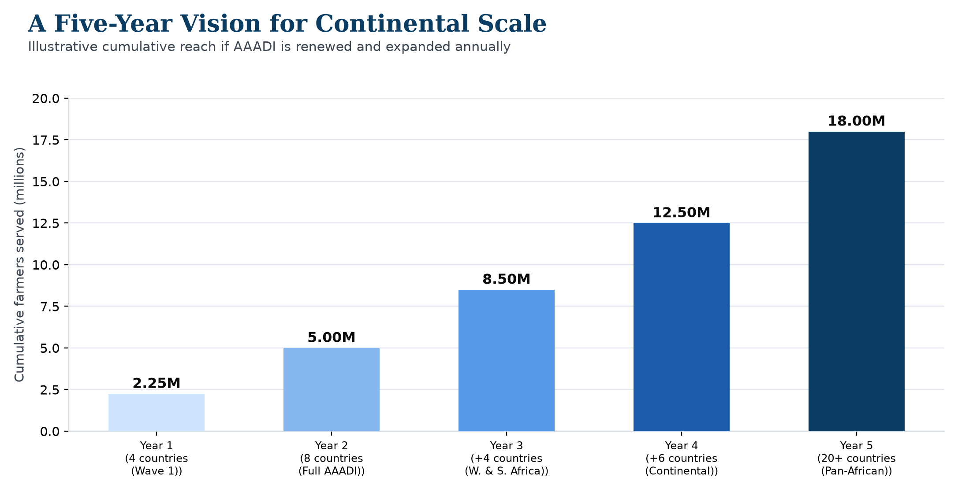
A Five-Year Vision
Catholic Project Fund · AAADI Stakeholder Presentation
27

Slide 28
Join Us
A transparent $1,625 unit of investment that scales from a single sponsor to a $812,500,000 Global Partner commitment — with quarterly reporting against every KPI in this presentation.
NEXT STEPS
› Contact the Catholic Project Fund Partnerships Office to discuss tier and country preference
› Execute a partnership agreement outlining terms and reporting cadence
› Receive recognition placement and your first quarterly report after Months 1–2 governance close
Catholic Project Fund · AAADI Stakeholder Presentation
28

Slide 29
Thank You
Catholic Project Fund Partnerships Office
African Agricultural AI & Drone Initiative (AAADI) · July 2026

